Slide 1

Data Visualization Strategies
Week 1
Jan 12, 2016

Slide 2
About Tommy
Computer Science (HCI focus) - Georgia Tech
Software Dev/Test Engineer - Microsoft
Data & Analytics - Optify
Data Analyst/Scientist - Zillow & Redfin
Data Visualization Lead – Qumulo

Slide 3
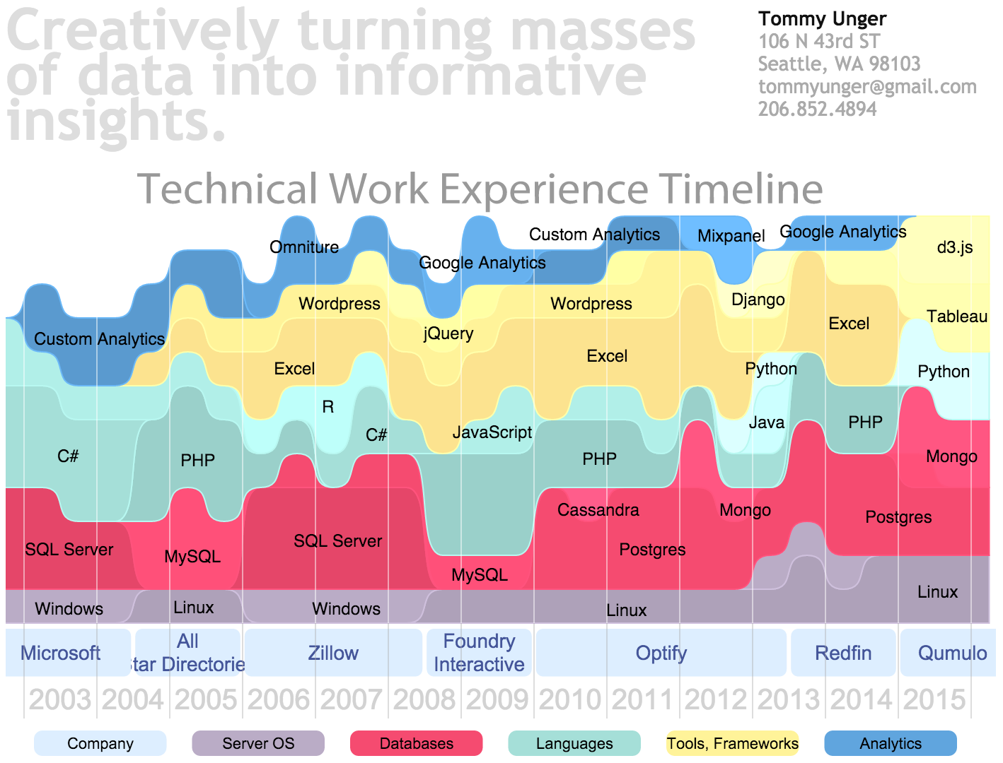
http://tommyunger.com/resume

Slide 4
Course Design
Lectures
Class participation and discussion
Exercises with tools, individual and/or group
Weekly homework
Readings
“Research”
Using tools
Small write-ups or “quizzes”
Individual final project

Slide 5
How I spend my time currently

Slide 6
Grading
The course is Pass / No Pass / Incomplete
To pass, you must:
Attend Class – 8 of 10 sessions
Complete weekly assignments – 7 required
Complete a satisfactory final project
Discussion and participation in class exercises: 30% of total grade
Completion of homework assignments: 30%
Final individual project: 30%
Attendance: 10%

Slide 7
What to Bring to Class
PC or Mac laptop
Excel
Tableau
Optional: RStudio
Optional: Python
Optional: D3.js

Slide 8
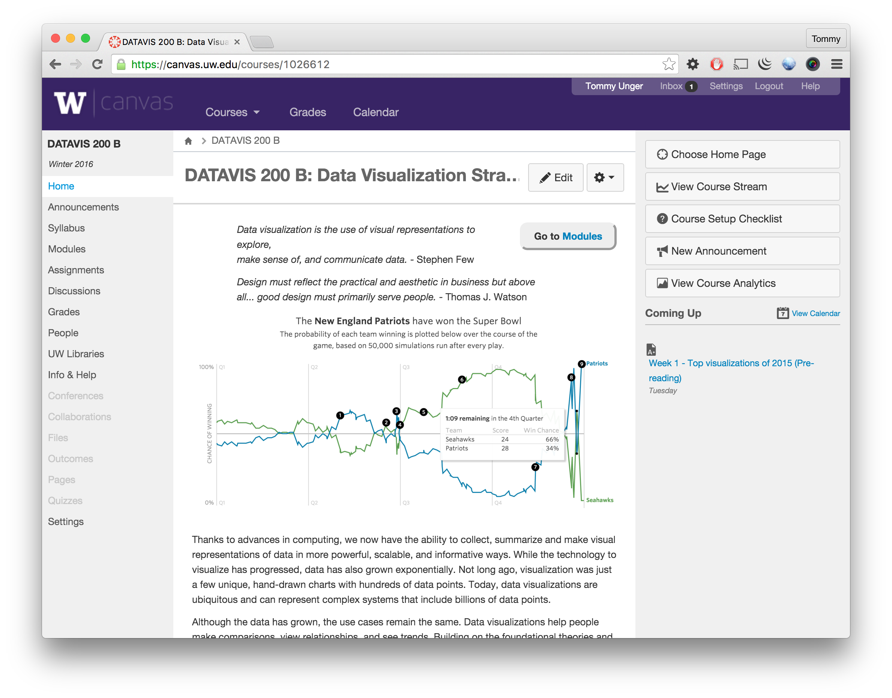
Website: https://canvas.uw.edu/courses/1026612

Slide 9
Topics in Data Visualization Strategies
Data sourcing and preparation: data types, data preparation
Data visualization solution design: understanding your audience, user experience, delivery strategy, platforms
Tools: familiarity and experience with visualization tools
The cloud: visualization and usage of cloud-based solutions
Roles & responsibilities: planning for collaborative analysis

Slide 10
Week 1 Topics
Review of Data Visualization Theory: A Practical Introduction
Top Visualizations of 2015

Slide 11
Review:
Data Visualization Theory:
A Practical Introduction

Slide 12
Exercise: Top learnings
Divide up into groups of ~3
What were your 3 most important learnings from Ben’s Data Visualization Theory: A Practical Introduction?
If you’re online, what was your #1 learning from Ben’s class?

Slide 13
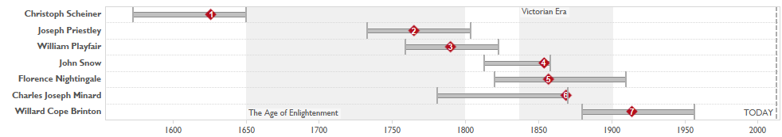


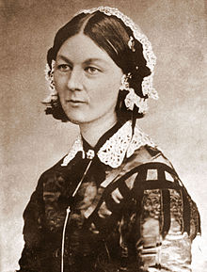
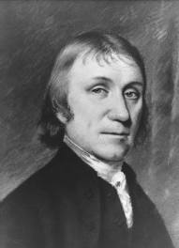
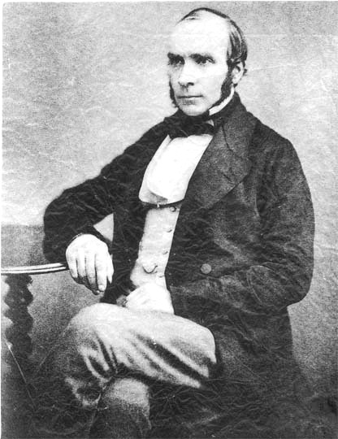

Data visualization pioneers
?

Slide 14

What we learned from the pioneers
Explore with an open mind
Seek to educate
Use your imagination
Go to the source
No excuses, no fear
Apply your unique perspective
Respect the data

Slide 15
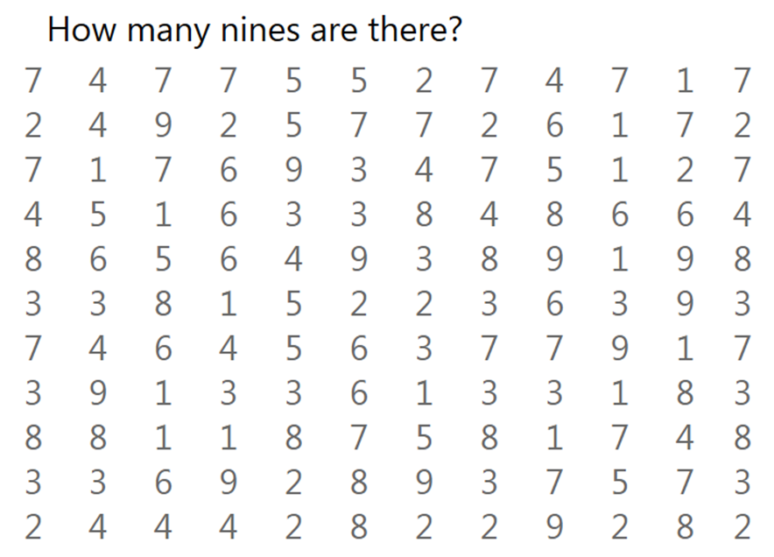
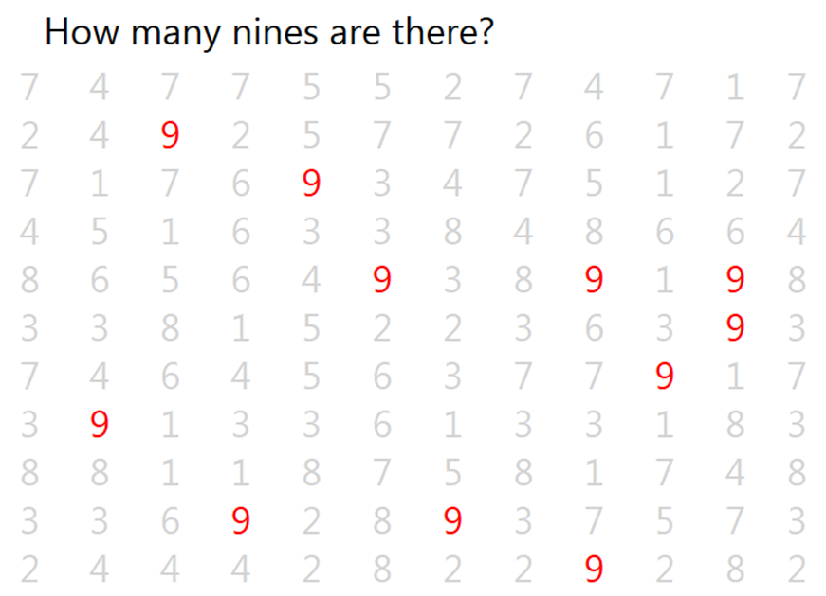
Cognition and perception

Slide 16
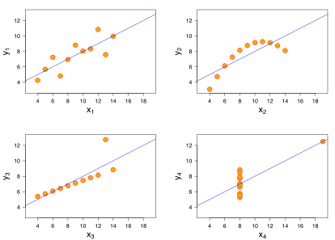

Why we visualize
Francis Anscombe

Slide 17
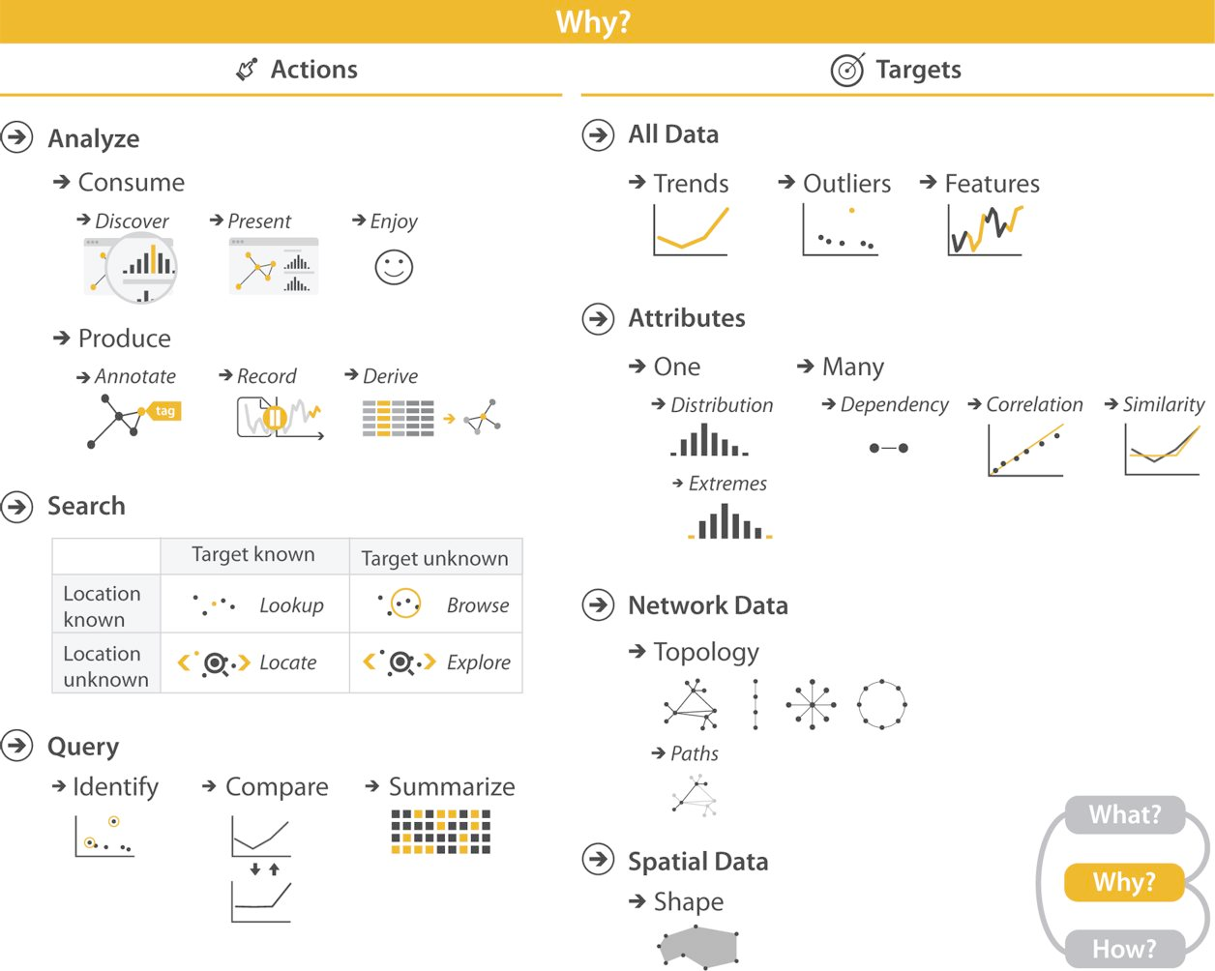
Why we visualize

Slide 18
Tamara Munzner’s 8 Rules of Thumb
No Unjustified 3D
No Unjustified 2D
Eyes Beat Memory
Resolution over Immersion
Over first, Zoom and Filter, Detail on Demand
Responsiveness Is Required
Get it Right in Black and White
Function First, Form Next

Slide 19
Visualization techniques
Visualizing tables of data
Change over time
Spatial data
Multiple quantities
Facets, partitions, grouping
Exploratory vs explanatory
Dashboards

Slide 20
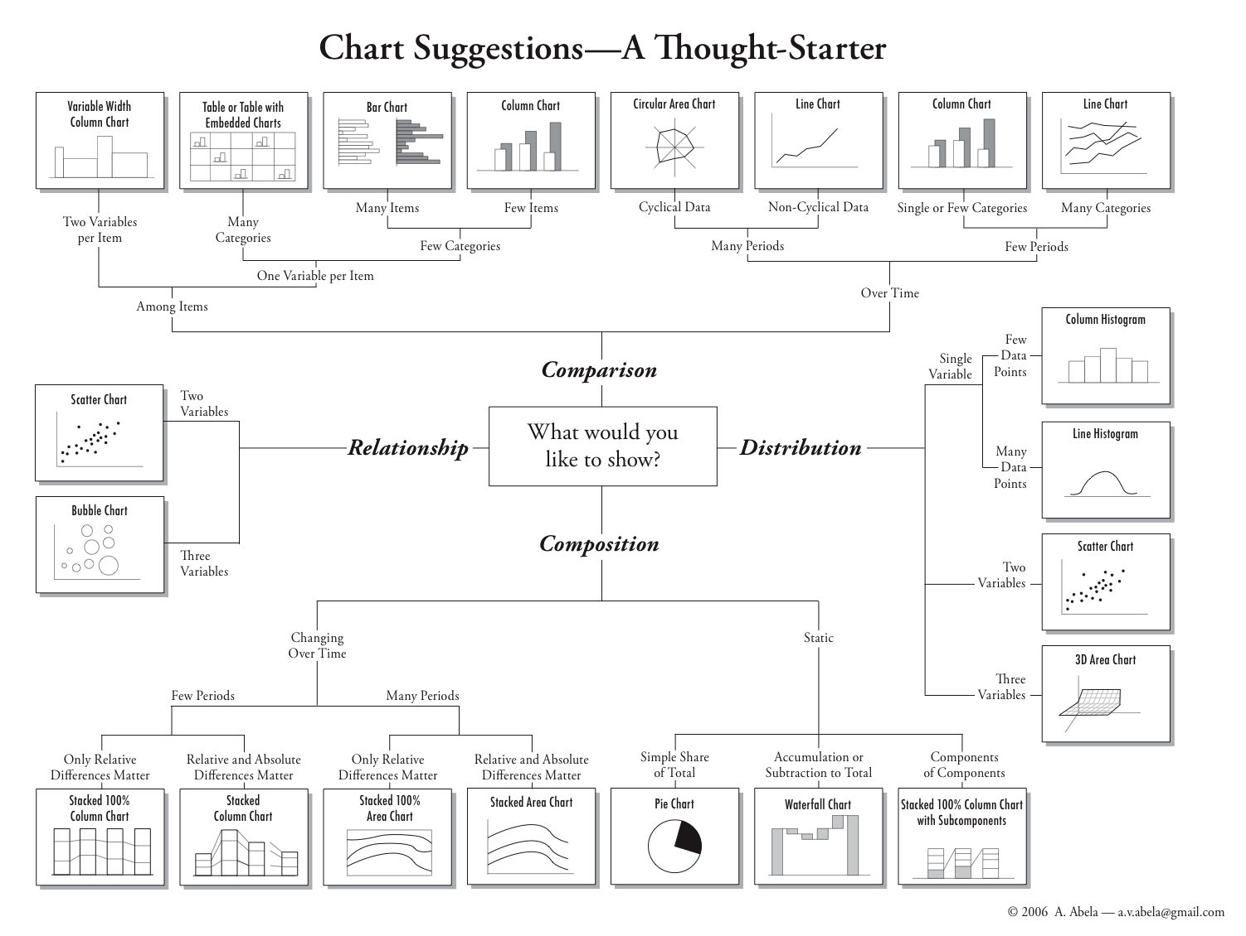
Data and visual solutions

Slide 21
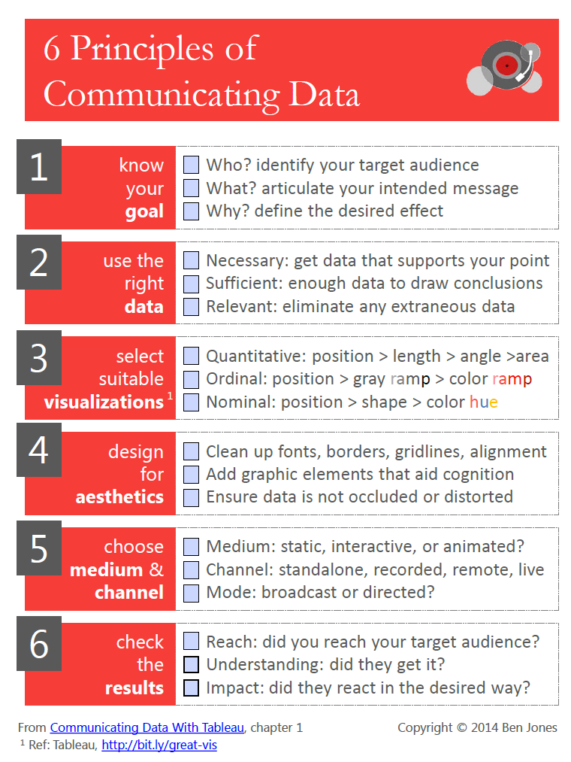

Slide 22
Top visualizations of 2015

Slide 23
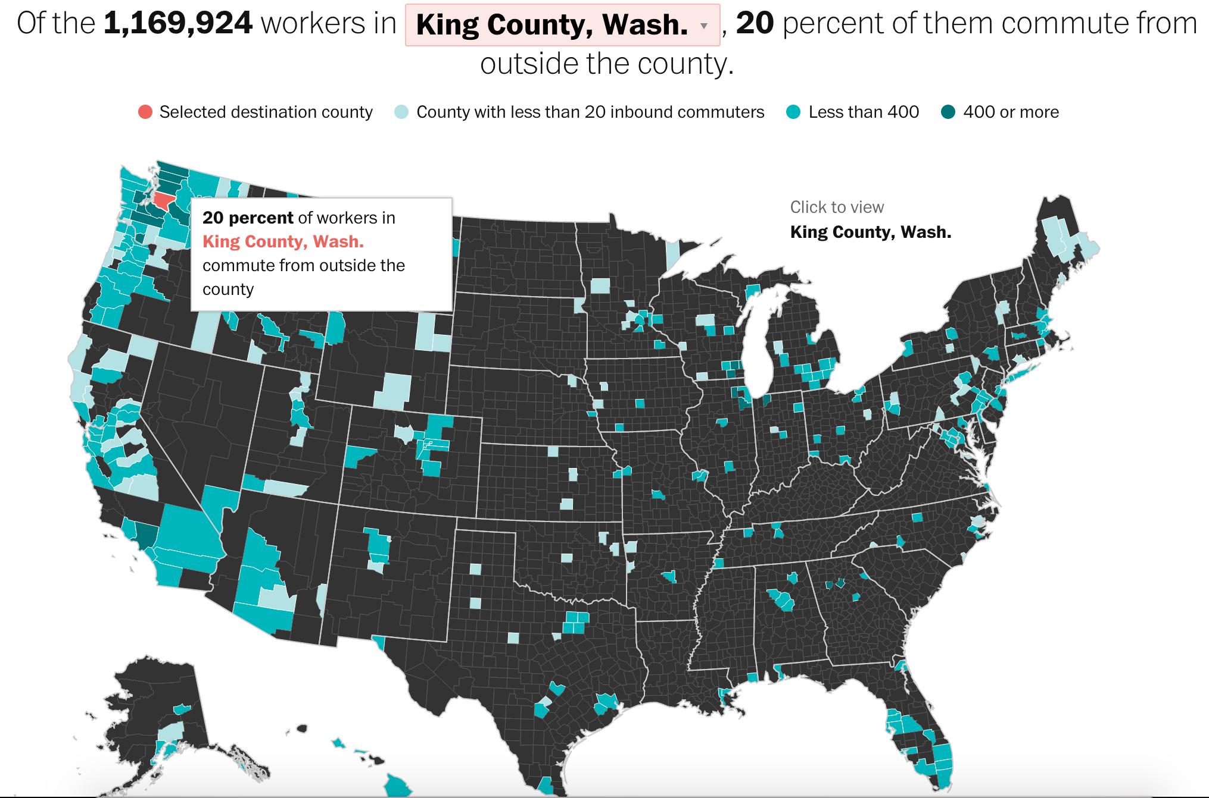
Washington Post: Commutes
Source: Census ACS
Positives
Nationwide data – Can be used ball all readers across US. Also, has a personal aspect with a filter to each county
Good use of color – Simple color scale
Search interaction – autocompletion allows quick filter to a county.
Negatives
Commutes are local – Counties are large, but commutes tend to be comprehended locally or hyper-locally.
Uses percent & numbers – Consistency of metrics is always preferred.
Numeric thresholds lack meaning – 20 and 400? Why?
Look at the comments…
https://www.washingtonpost.com/graphics/national/census-commute-map/

Slide 24
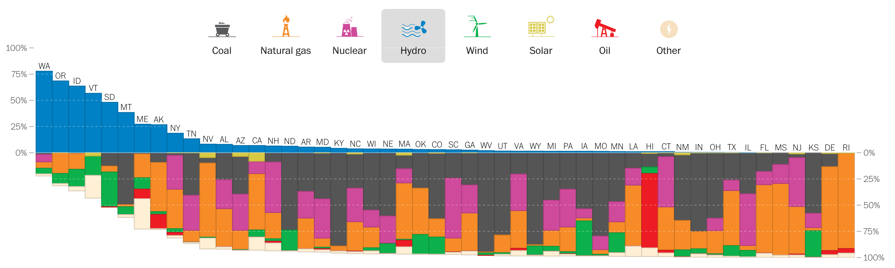
Washington Post: Energy
Positive
The icons are a nice touch
Negative
Individual maps below
https://www.washingtonpost.com/graphics/national/power-plants/

Slide 25
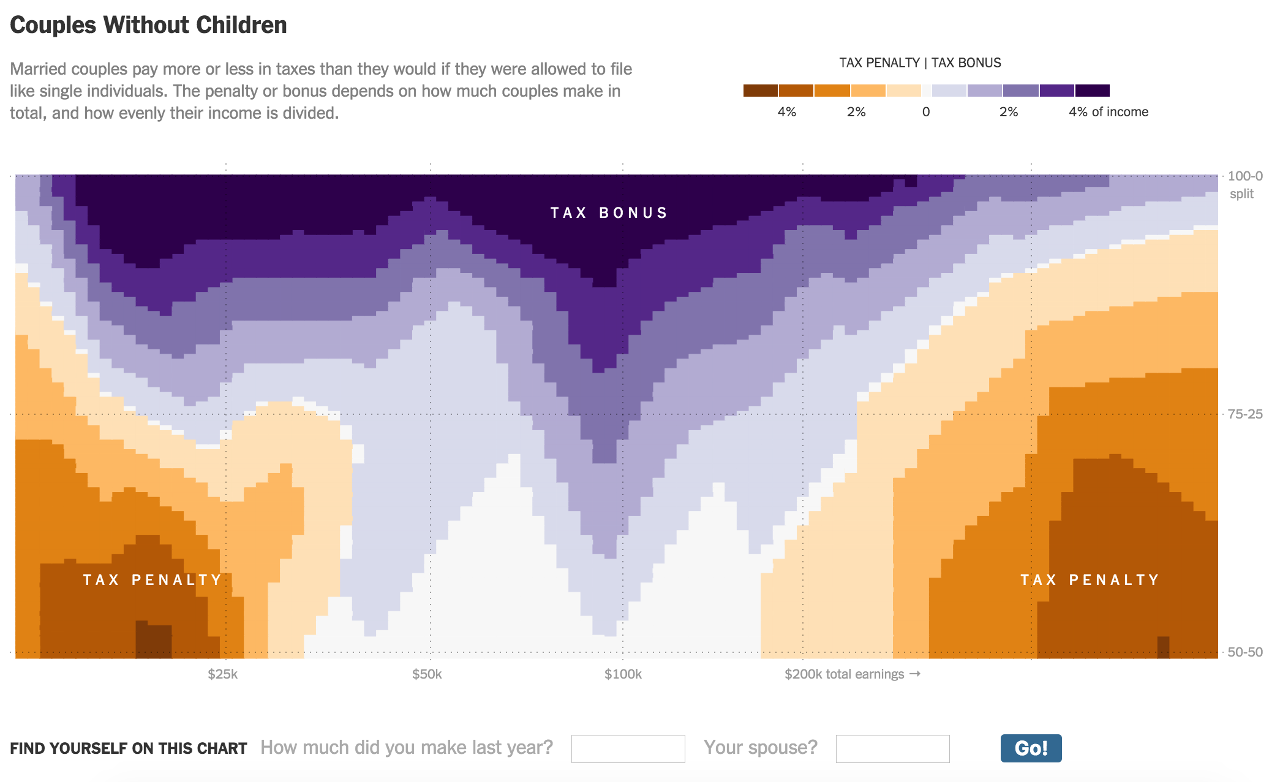
Income Taxes, Married Couples
Positives
Simple interaction
Negatives
Smaller audience
http://www.nytimes.com/interactive/2015/04/16/upshot/marriage-penalty-couples-income.html

Slide 26
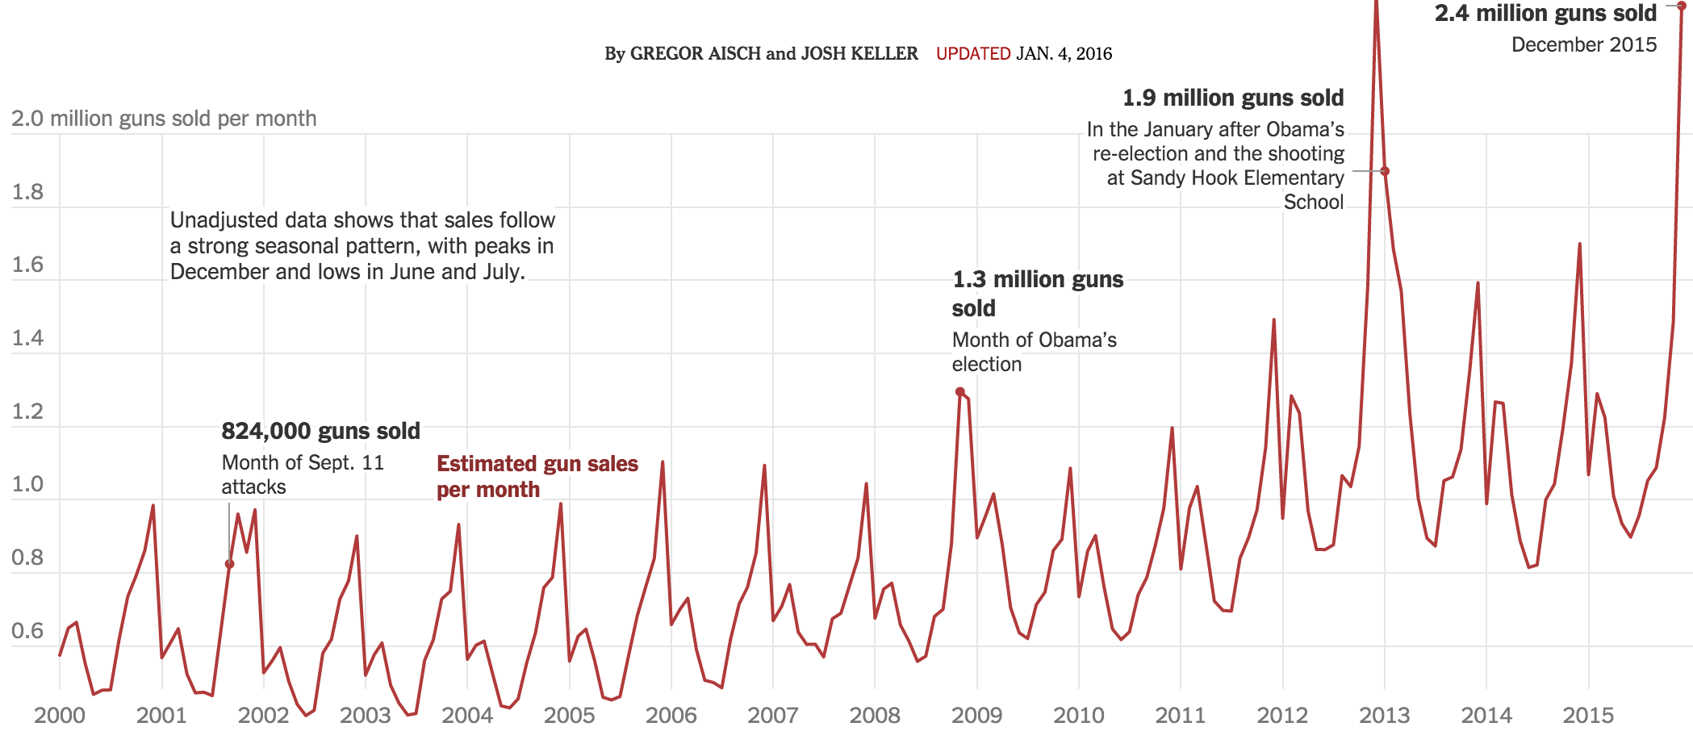
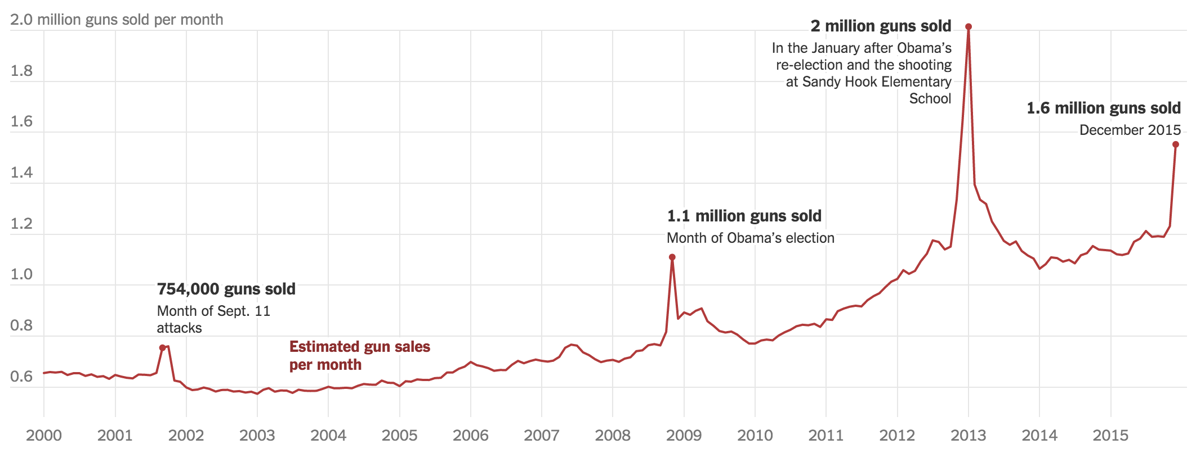
Historical Gun Sales
Positive
Seasonal adjustment
Negative
Adjustment interaction
http://www.nytimes.com/interactive/2015/12/10/us/gun-sales-terrorism-obama-restrictions.html

Slide 27
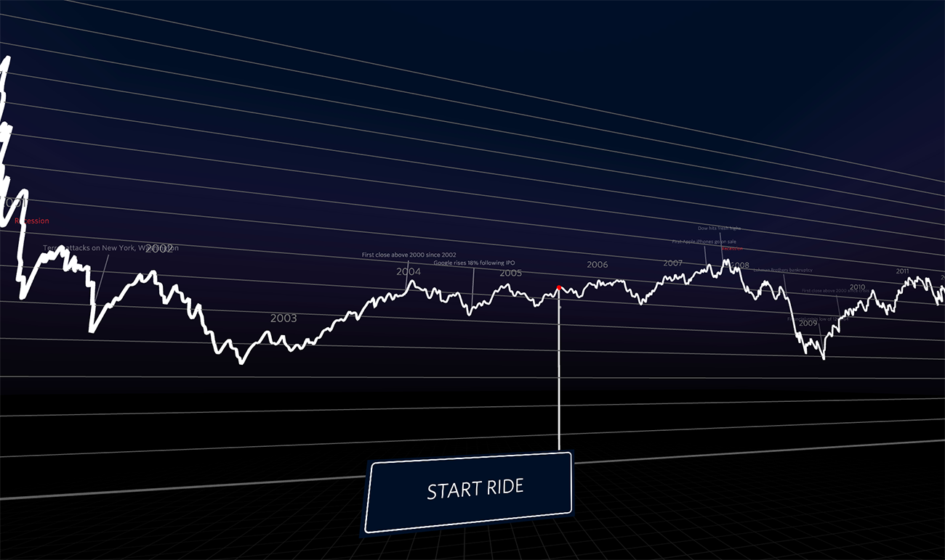

NASDAQ Index Price Rollercoaster
Positives
Fun
Negatives
…
http://graphics.wsj.com/3d-nasdaq/

Slide 28
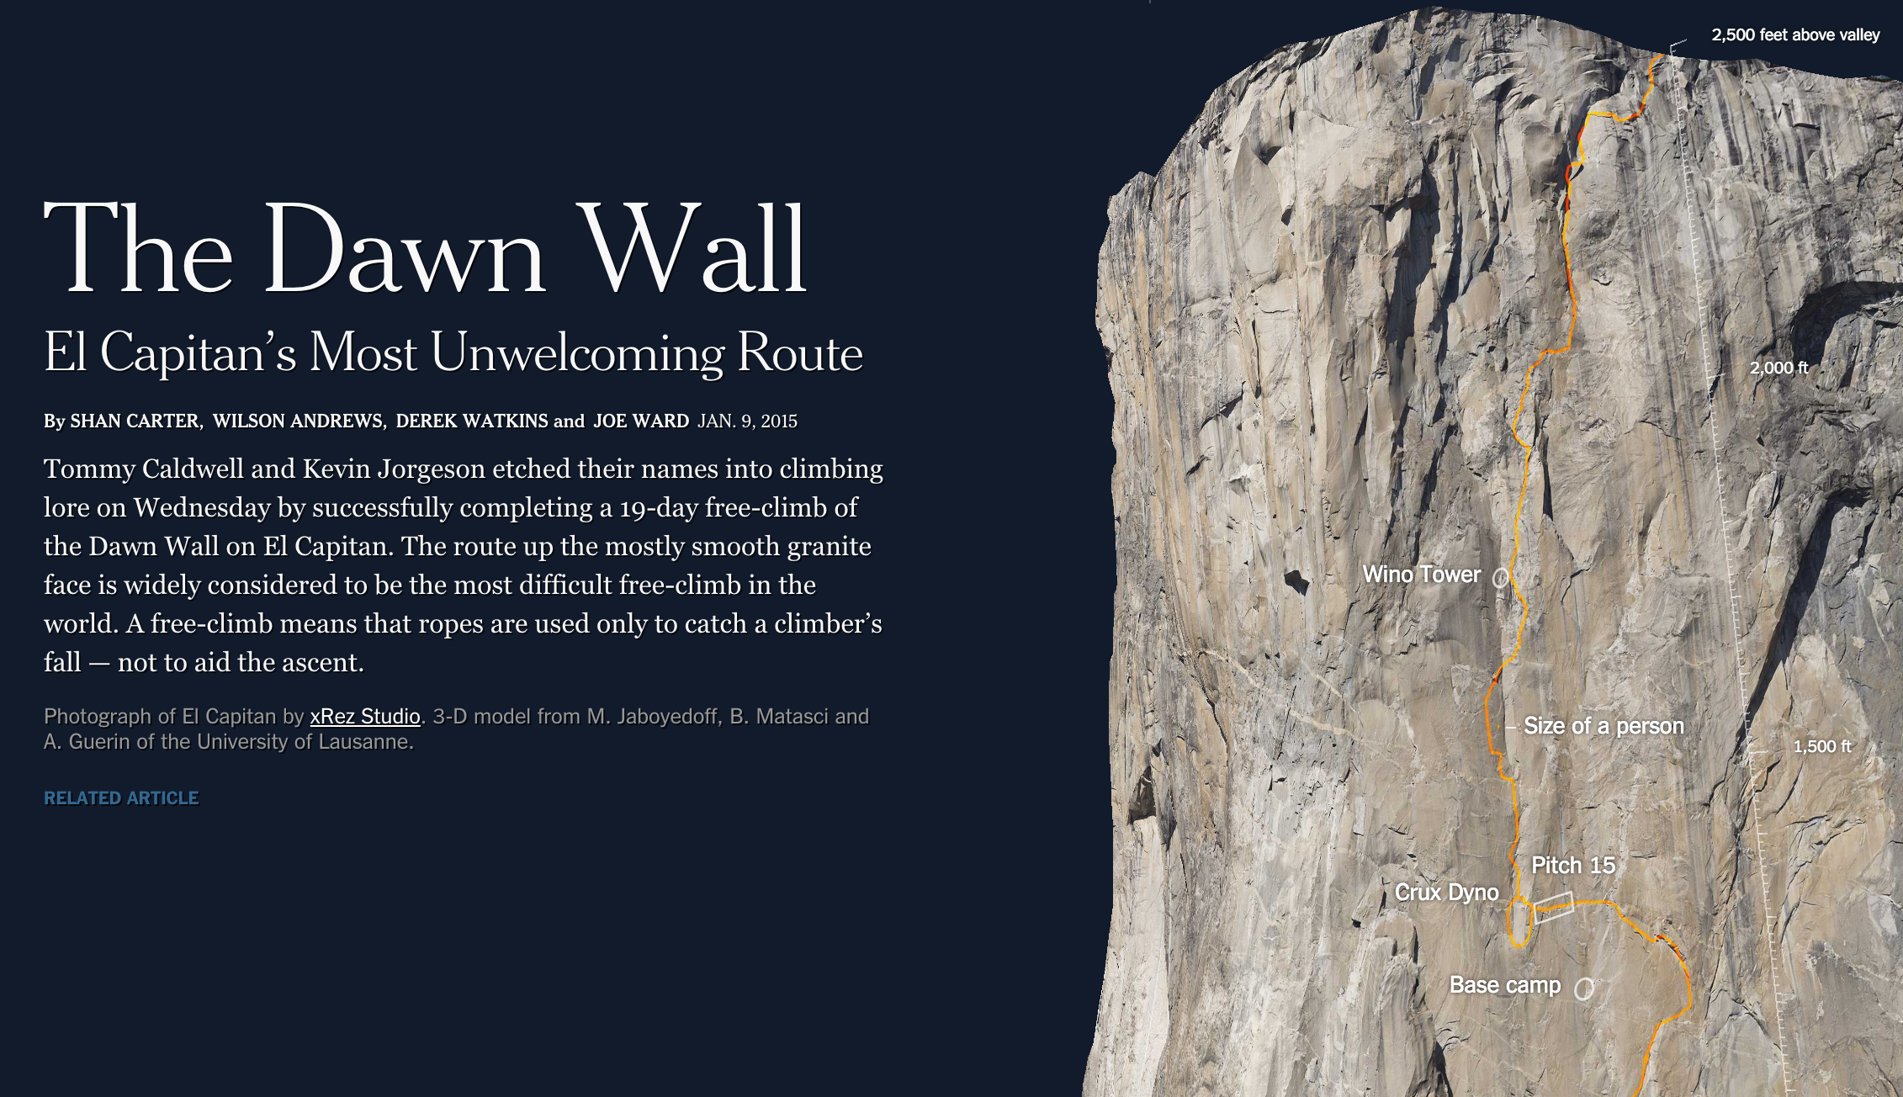
Climbing El Capitan Wall
Positive
Good use of 3d
Negative
No interaction on the wall
http://www.nytimes.com/interactive/2015/01/09/sports/the-dawn-wall-el-capitan.html

Slide 29
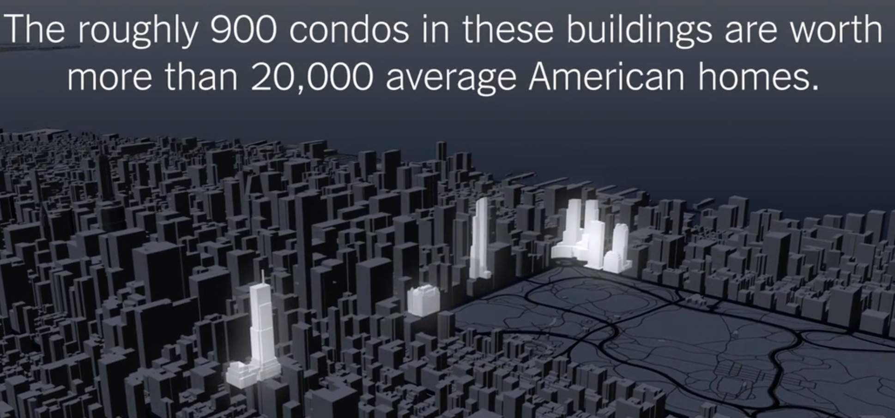
NYC Real Estate & Foreign Wealth
Positive
Good job dealing with scale
Negative
Video only way to see data
http://www.nytimes.com/2015/02/08/nyregion/stream-of-foreign-wealth-flows-to-time-warner-condos.html

Slide 30
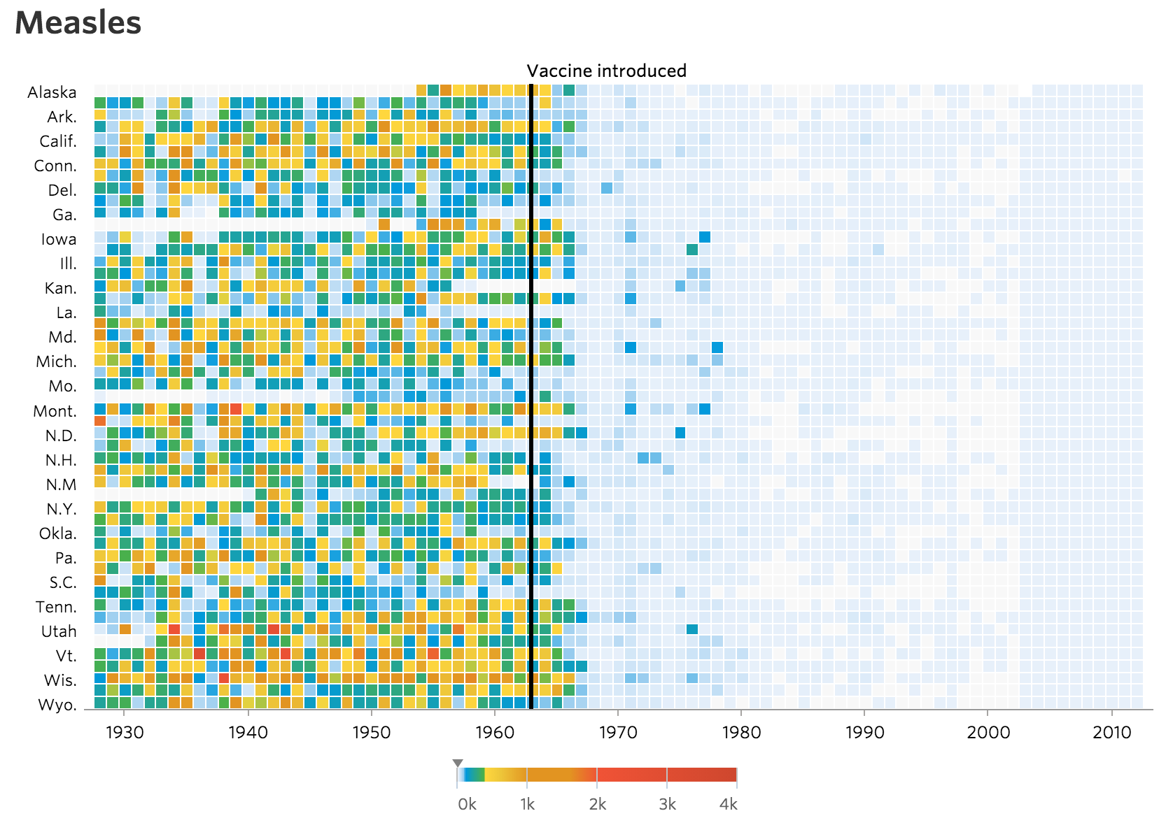
Vaccines and Infectious Diseases
Positive
Visualizations support the science
Negative
Nice to have a little more narrative
http://graphics.wsj.com/infectious-diseases-and-vaccines/

Slide 31
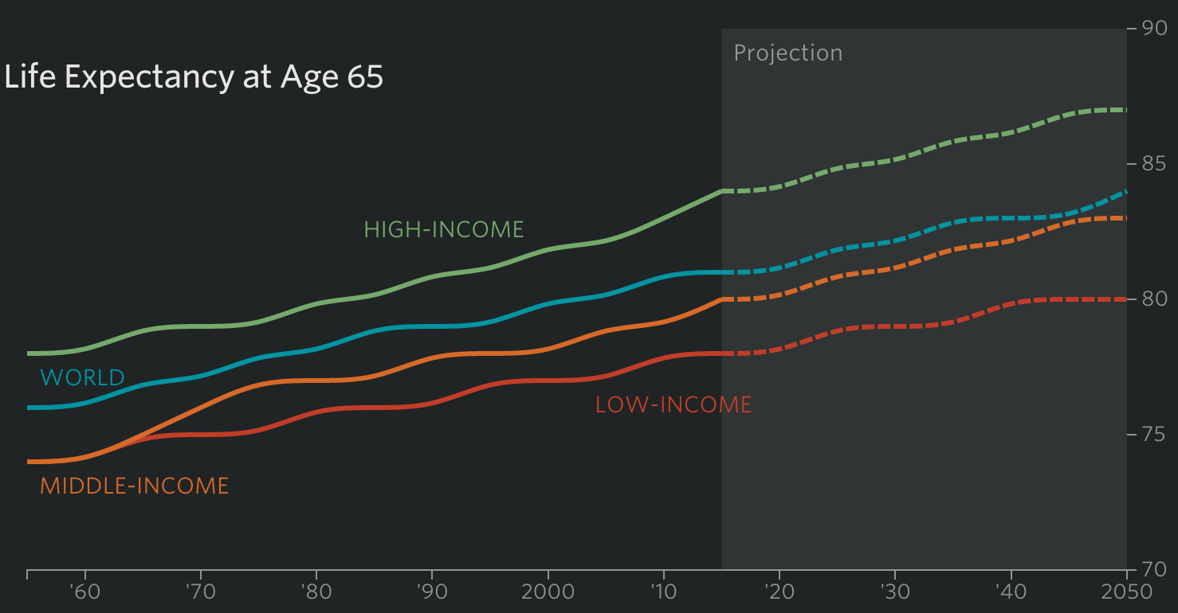
WSJ Demographics
Positives
Part of a huge feature
Negatives
Header interactions not helpful
http://www.wsj.com/articles/how-demographics-rule-the-global-economy-1448203724

Slide 32
Exercise: Analyze a Visualization
Pick one visualization from the top of 2015 and answer the following:
Add a feature, remove a feature. Describe one thing you would add to the viz and one thing you'd remove.

Slide 33
One more thing

Slide 34
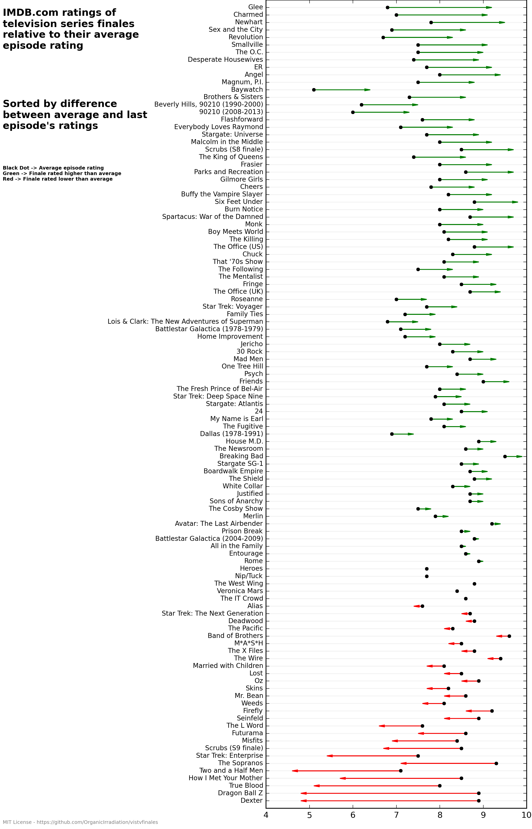
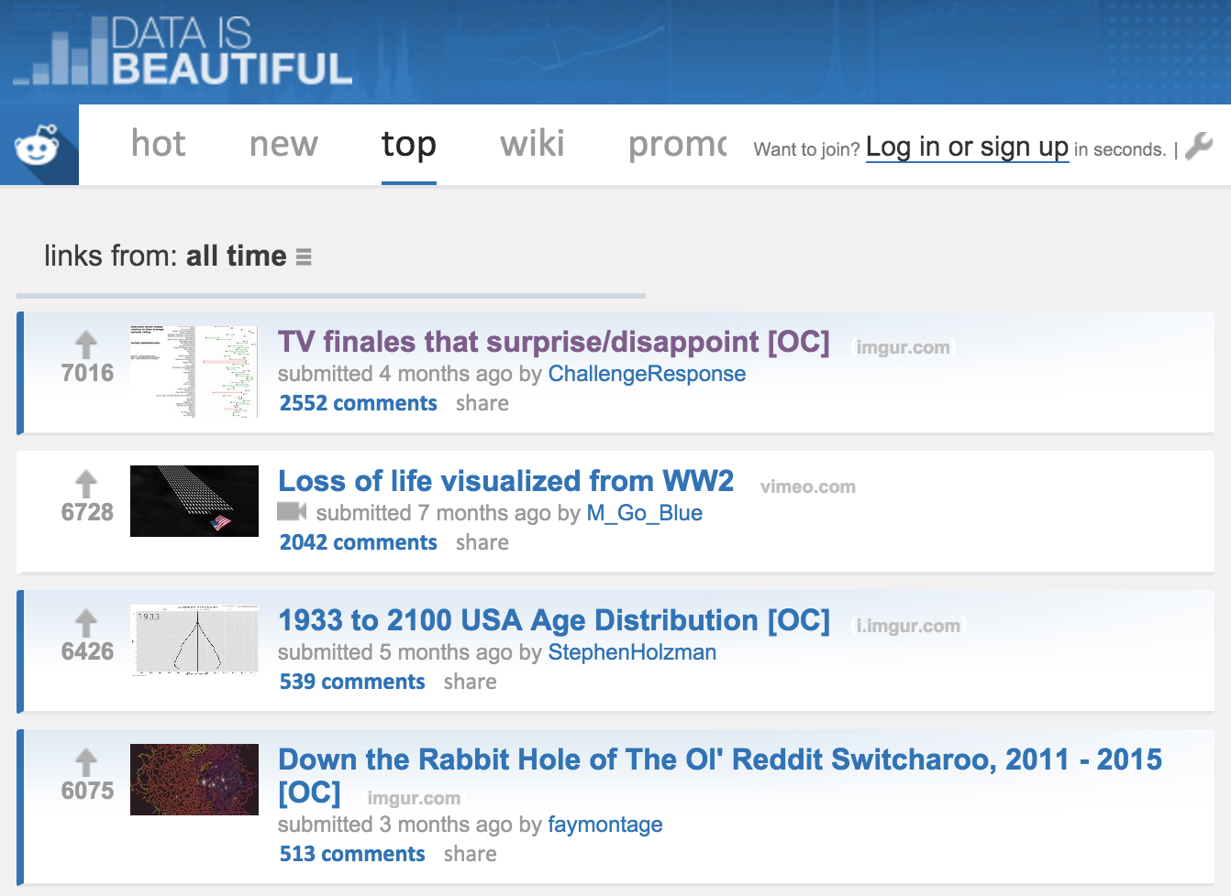
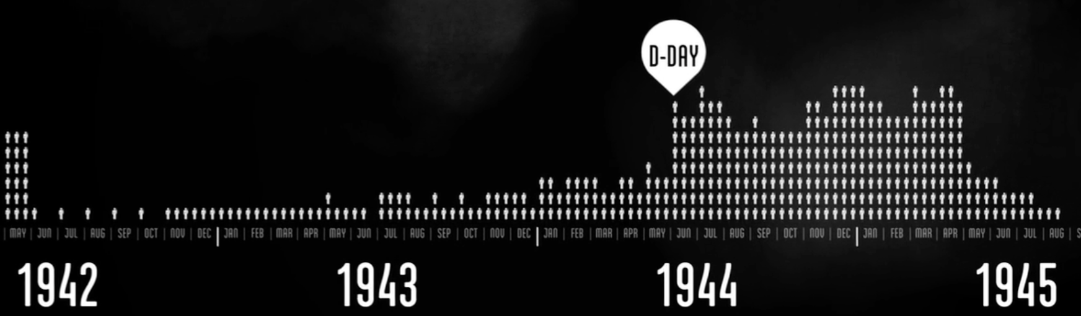
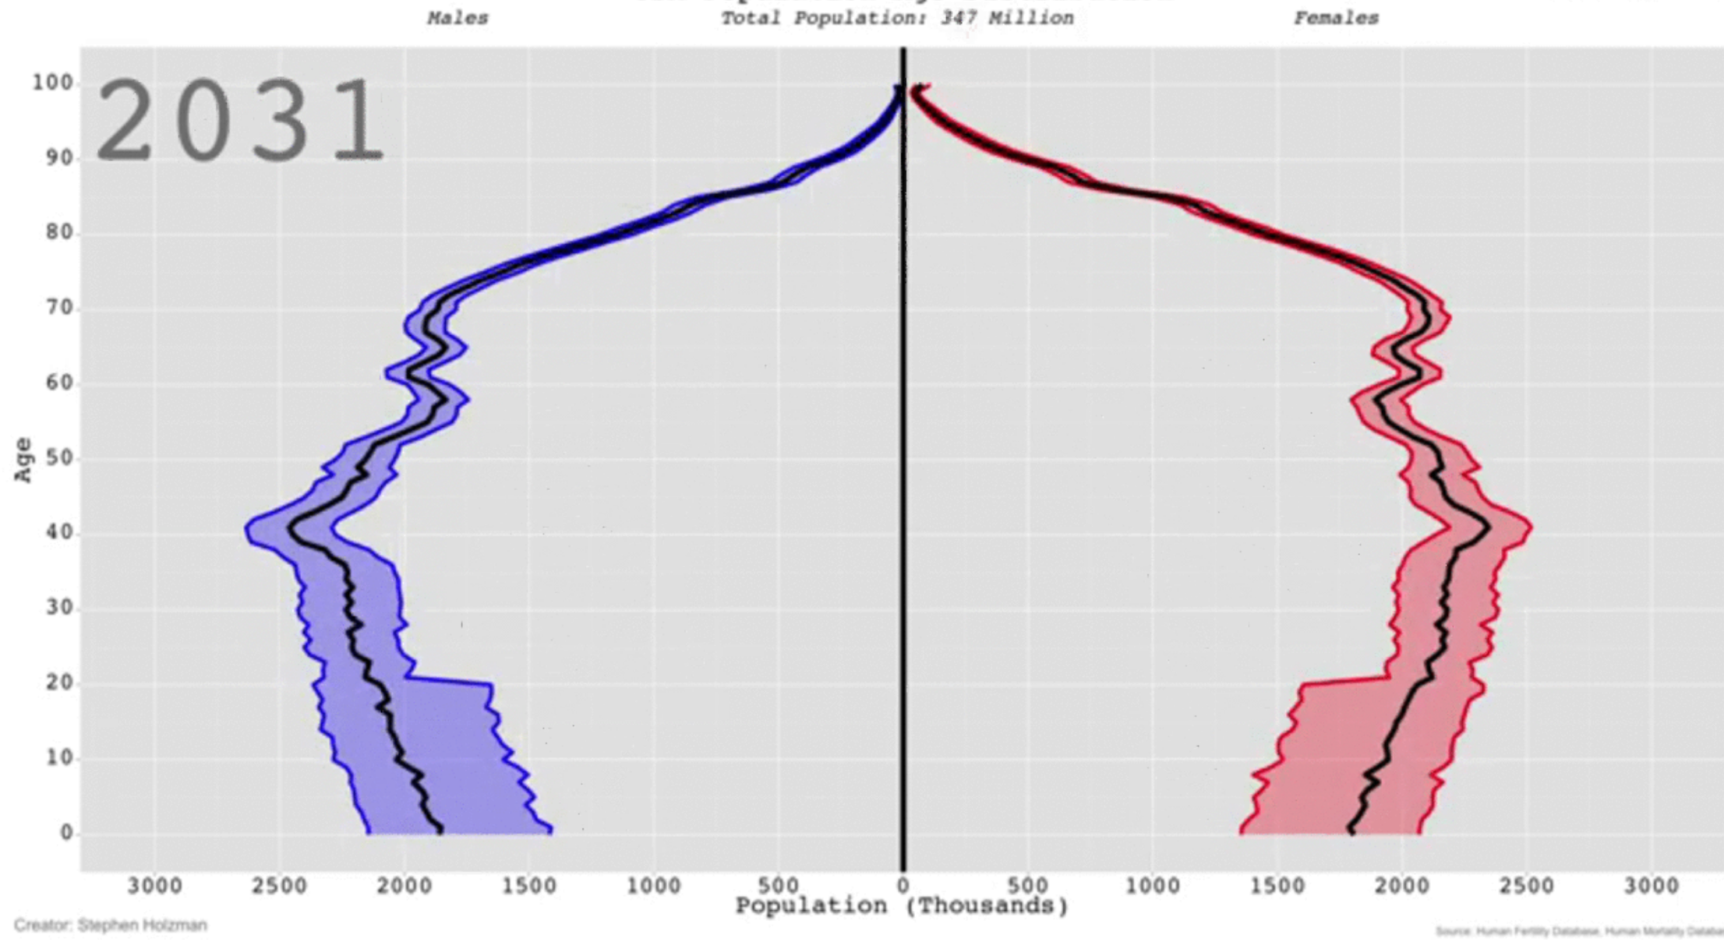
Top visualizations of 2015
Reddit’s Data as beautiful, top of past year:
https://www.reddit.com/r/dataisbeautiful/top/?sort=top&t=all

Slide 35
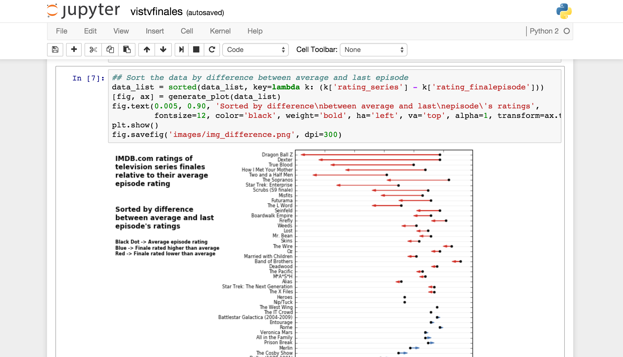
Top visualizations of 2015
Top Reddit visualization:
https://imgur.com/a/IoVY5
Open source iPython code:
https://github.com/OrganicIrradiation/vistvfinales

Slide 36
Homework, due Week 2
Pick two visualizations from the top of 2015 and answer the following:
Identify the data source.
Describe the data (time series, categorical, geographic, etc)
Identify 3 or more positive aspects of the data visualization? Why are they positive?
Identify 3 or more negative aspects of the data visualization? Why are they negative?
Find your own list of top visualizations of 2015 (or some other current list)
Complete your bio/profile on UW Canvas

